Slide 1

Design and Implementation of an Autocomplete System using Trie and Bloom Filter
A comprehensive exploration of efficient data structures for intelligent word prediction

Slide 2
Introduction to Autocomplete Systems
What is Autocomplete?
Core Technologies
Autocomplete is a sophisticated system that predicts and suggests words as a user types, significantly reducing typing effort and minimizing input errors. This technology has become ubiquitous in modern applications, from search engines to mobile keyboards, enhancing user experience through intelligent prediction.
Trie: Enables rapid prefix-based word searching with optimal time complexity
Bloom Filter: Provides probabilistic checking to eliminate invalid prefix queries
Project Goal
Persistence: Creates an adaptive, personalised experience across sessions
Our objective is to design and implement a highly efficient autocomplete system that delivers instant suggestions whilst maintaining low memory overhead and adapting to user behaviour over time.

Slide 3

Problem Statement
The fundamental challenge is to build a system capable of handling the complex demands of real-time word prediction whilst maintaining exceptional performance and user satisfaction.
Instant Retrieval
Deliver suggestions in milliseconds based on user's typed prefix, ensuring seamless interaction
Resource Efficiency
Avoid wasting computational resources on searches for invalid prefixes that don't exist in the dictionary
Intelligent Ranking
Prioritise frequently used words to provide contextually relevant suggestions
Session Memory
Remember user preferences and word frequencies across multiple sessions for personalisation

Slide 4
Project Objectives
01
02
03
Trie Implementation
Bloom Filter Integration
Frequency Tracking
Develop an efficient Trie data structure optimised for prefix-based searching with minimal traversal time
Implement a probabilistic filter to eliminate unnecessary Trie lookups for non-existent prefixes
Build a robust frequency counter to track word usage and provide intelligently ranked suggestions
04
05
Persistent Storage
CLI Demonstration
Create a persistence layer to save and load word frequencies seamlessly across sessions
Develop a command-line interface to demonstrate the complete system functionality

Slide 5




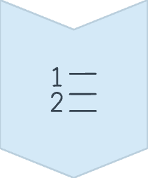

System Architecture & Workflow
The autocomplete system follows a carefully orchestrated workflow that maximises efficiency whilst maintaining data integrity throughout the user session.
Startup
Load pre-built Trie, Bloom Filter, and frequency dictionary from state file
Input
User types a prefix into the system
Filter Check
Bloom Filter verifies prefix existence
Trie Search
Traverse Trie to collect matching words
Ranking
Sort by frequency and alphabetically
Shutdown
Persist updated frequencies to file

Slide 6

Core Technology 1: The Trie
What is a Trie?
A Trie, also known as a prefix tree, is a specialised tree-like data structure optimised for storing and retrieving strings efficiently. Each node represents a single character, and paths from the root to leaf nodes form complete words.
Why Use It?
The Trie enables remarkably fast prefix-based searches. Finding all words starting with "auto" requires only traversing a specific path in the tree, making it ideal for autocomplete functionality.
Efficiency Advantages
Search time is proportional to the length of the prefix (L), not the total number of words (W) in the dictionary. This means performance remains consistent even with massive vocabularies.

Slide 7

Core Technology 2: The Bloom Filter
What is it?
How it Works
A space-efficient probabilistic data structure designed to test set membership with minimal memory overhead. It trades perfect accuracy for exceptional speed and compactness.
Uses multiple hash functions to set bits in a bit array. To check for an element, it hashes it using the same functions and verifies if all corresponding bits are set.
Role in Our System
Acts as a gatekeeper for the Trie. It can definitively say "this prefix is not in our dictionary," saving costly Trie searches. May produce false positives but never false negatives.

Slide 8
Core Technology 3: Ranking & Persistence
Frequency Counter
Persistence Layer
At the heart of intelligent suggestion ranking lies a frequency counter—a dictionary structure that maps each word to its usage count. When a user selects a suggested word, the system increments its count, ensuring that more relevant and frequently used words progressively appear higher in future suggestion lists.
To ensure frequency rankings persist between sessions, the system employs Python's pickle module for serialization. This elegant solution allows the entire frequency dictionary to be saved to a file upon exit and seamlessly reloaded on startup.
The persistence mechanism transforms the autocomplete system from a stateless tool into an adaptive assistant that remembers user behaviour across multiple sessions, significantly enhancing long-term utility.
This adaptive mechanism allows the system to learn user preferences over time, creating a personalised autocomplete experience that improves with continued use.

Slide 9



Algorithm: Word Insertion
When a new word is added to the autocomplete system, three distinct data structures must be updated in a coordinated fashion to maintain system integrity and functionality.
Bloom Filter Addition
Trie Insertion
The word itself, along with all of its prefixes, are added to the Bloom Filter. This comprehensive approach ensures the filter can later verify any potential prefix during suggestion queries.
Frequency Dictionary Update
The word is inserted character by character into the Trie data structure. Each character creates or traverses a node, with the final character marked as a word endpoint.
If the word is new to the system, it's added to the frequency dictionary with an initial count of zero. This prepares the word for future frequency tracking and ranking.

Slide 10

Algorithm: Getting Suggestions
1
Bloom Filter Check
First defence: verify if the typed prefix exists in the Bloom Filter. If not, immediately return empty list.
2
Trie Traversal
If check passes, traverse the Trie to locate the node corresponding to the prefix's final character.
3
Word Collection
From that node, perform depth-first search to gather all descendant words that share the prefix.
4
Intelligent Sorting
Sort collected words by frequency (descending), then alphabetically, before presentation to user.

Slide 11


Algorithm: System Lifecycle
System Startup
System Shutdown
Upon initialization, the system first checks for the existence of a state file containing previously saved data. If the file exists, it loads the entire state object—including the Trie structure, Bloom Filter bit array, and frequency dictionary—directly into memory.
When the program exits—whether through normal termination or user command—the system enters its shutdown sequence. It opens the designated state file in write mode, ensuring any existing data will be replaced with the current state.
If no state file is found, the system initializes new, empty data structures, ready to begin building its vocabulary from scratch. This dual-path approach ensures the system functions correctly whether starting fresh or resuming from a previous session.
The system then serializes the complete frequency dictionary and writes it to the file, preserving all learned patterns and user preferences for the next session. This graceful shutdown ensures no data loss and maintains system continuity across sessions.

Slide 12
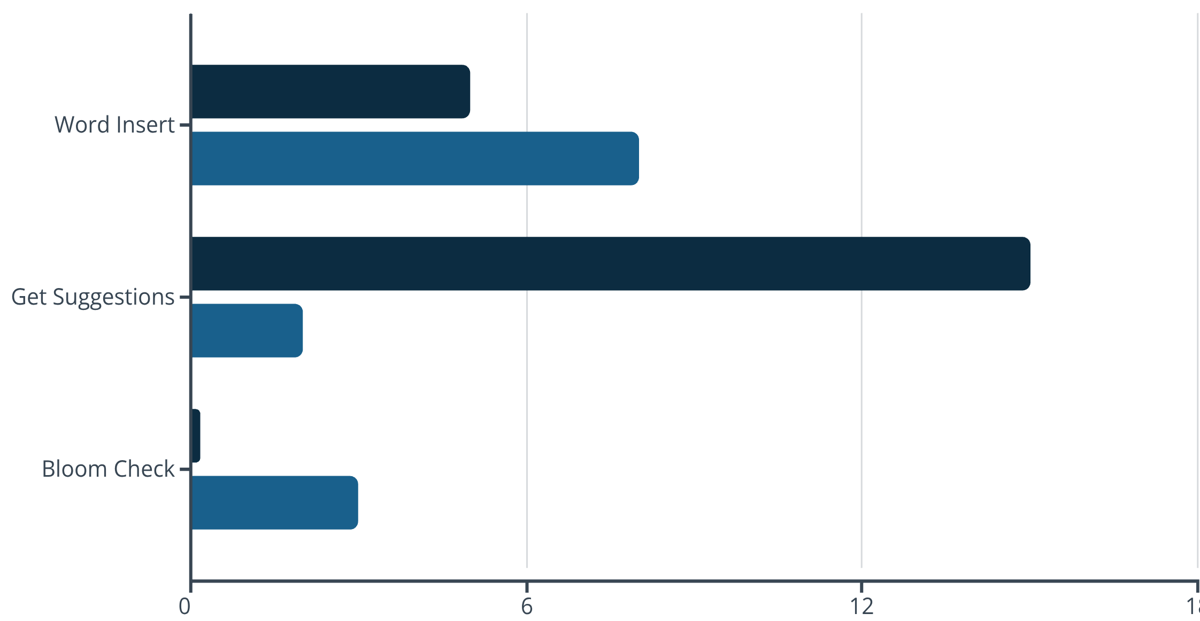

Complexity Analysis: Time
Understanding the time complexity of each operation is crucial for evaluating system performance and scalability. The following table presents the worst-case time complexities for core operations.
Trie Component
Bloom Filter Component
Key Variables: L = average word length, k = number of hash functions, S = number of suggestions returned, m = number of nodes in Trie sub-tree, s = size of state file
Insert Operation: O(k · L) — Dominated by Bloom Filter updates requiring k hash computations per character
Get Suggestions: O(L + m + S log S) — Trie traversal plus sorting collected suggestions
Startup Load: O(s) — Linear in the size of the state file being deserialized

Slide 13



Complexity Analysis: Space
Trie Structure
Bloom Filter
Frequency Dictionary
O(W · L)
O(M)
O(W)
Memory consumption is proportional to the total number of characters across all stored words. Each character requires a node in the tree structure.
Memory is based solely on the bit array size (M), which remains constant regardless of the number of elements inserted.
Memory scales linearly with the number of unique words in the system. Each word requires one entry mapping to its frequency count.
For a dictionary with W words averaging L characters each, the space complexity grows linearly with vocabulary size.
This makes the Bloom Filter extremely space-efficient, typically requiring only a few kilobytes even for large dictionaries.
This structure is memory-efficient, storing only word references and integer counters.

Slide 14

Design Trade-offs
Trie Characteristics
Bloom Filter Trade-offs
The Synergy
Advantages: Provides 100% accurate prefix searches with predictable performance. No false positives or negatives.
Advantages: Extremely fast lookups and highly memory-efficient, using only a small bit array regardless of dictionary size.
The combination provides a practical balance. The Bloom Filter acts as a fast, low-memory screen that protects the slower, memory-intensive Trie from unnecessary work.
Disadvantages: Can be memory-intensive with large dictionaries, especially for languages with extensive vocabularies.
Disadvantages: Produces false positives—may incorrectly indicate a prefix exists when it doesn't.
False positives result in harmless Trie lookups but don't affect final output correctness, making this an optimal architecture.

Slide 15




Testing & Evaluation Strategy
The system underwent rigorous validation through a comprehensive test suite designed to verify both individual component functionality and integrated system behaviour.
Valid Prefix Testing
Invalid Prefix Rejection
Persistence Verification
Verified that the system correctly retrieves and ranks suggestions when presented with valid prefixes that exist in the dictionary. Tests confirmed proper Trie traversal and frequency-based sorting.
Confirmed that the Bloom Filter successfully identifies non-existent prefixes and prevents unnecessary Trie lookups, validating the efficiency optimization layer.
Tested that frequency data correctly persists across program restarts, ensuring the system maintains learned patterns and user preferences between sessions.

Slide 16

Test Case: Valid Prefix Suggestions
These test cases demonstrate the system's ability to correctly retrieve and rank suggestions for valid prefixes present in the dictionary.
Test Input: Prefix 'ca'
Test Input: Prefix 'do'
Expected Behaviour: System should traverse Trie to 'ca' node and collect all descendant words
Expected Behaviour: System should efficiently locate 'do' prefix and retrieve matching words
Result: ✓ Correctly suggested: cat, car, cart, case, carbon
Result: ✓ Correctly suggested: dog, door, dot, dove
Verification: All returned words share the 'ca' prefix and are sorted by frequency then alphabetically
Verification: Suggestions returned in milliseconds with proper ranking applied
Test Outcome: These successful tests confirm that both Trie traversal and suggestion collection algorithms are functioning correctly. The system demonstrates accurate prefix matching and efficient word retrieval.

Slide 17


Test Case: Invalid Prefix & Persistence
Invalid Prefix Test
Persistence Test
Test Input: Prefix 'z' (assuming no dictionary words begin with 'z')
Test Procedure: Increased frequency count for the word "test", then terminated and restarted the program
Expected Behaviour: Bloom Filter should identify that no words with this prefix exist and immediately return without Trie lookup
Expected Behaviour: Upon restart, the system should load the updated frequency and rank "test" higher in suggestions
Result: ✓ System correctly loaded persisted frequency data and applied higher ranking
Result: ✓ System correctly returned "No suggestions" in microseconds
Significance: Confirms that the persistence layer functions correctly, maintaining user preferences across sessions and enabling adaptive behaviour over time.
Significance: Demonstrates that the Bloom Filter successfully fulfils its role as an efficiency gatekeeper, preventing wasteful Trie operations for invalid prefixes.

Slide 18
System Limitations
Whilst the autocomplete system demonstrates strong performance and functionality, several limitations warrant consideration for real-world deployment and future development.
1
2
3
Bloom Filter False Positives
Trie Memory Footprint
Command-Line Interface
The probabilistic nature of Bloom Filters means false positives are inevitable. When a false positive occurs, the system performs an unnecessary Trie lookup that ultimately yields no results.
Memory consumption grows linearly with the total number of characters stored across all words. For extremely large dictionaries—such as comprehensive medical or technical vocabularies—this can become substantial.
The current implementation uses a CLI, which limits direct usability for typical end-users who expect graphical interfaces. Integration into applications would require significant interface development.
Whilst this doesn't impact accuracy of final output, it does represent a minor efficiency overhead. The false positive rate can be tuned by adjusting filter size and hash function count.
The CLI is suitable for demonstration and testing but not for production deployment in consumer-facing applications.
In memory-constrained environments, the Trie's space requirements may necessitate alternative approaches or compressed variants.

Slide 19
Future Scope & Enhancements
Compressed Trie (Radix Tree)
GUI & Web Integration
Large-Scale Dictionary Support
Context-Aware Ranking
Develop a graphical user interface or deploy the system as a RESTful web service API. This would enable broader application integration and improve end-user accessibility.
Incorporate machine learning models to consider context through n-gram analysis. This would enable even smarter suggestions based on word sequences rather than just individual word frequencies.
Implement a more memory-efficient Trie variant that compresses chains of single-child nodes. This could significantly reduce space complexity for large dictionaries whilst maintaining search efficiency.
Optimize and rigorously test the system with massive dictionaries containing millions of words. This may require distributed data structures or database-backed storage solutions.

Slide 20

Conclusion
Project Summary
This project successfully designed and implemented an efficient autocomplete system by strategically combining the complementary strengths of a Trie data structure and a Bloom Filter. The system effectively balances speed and memory efficiency whilst providing relevant, frequency-based suggestions.
The persistence layer enables the system to adapt and personalise its rankings based on user history, making it progressively more useful over time. Through rigorous testing and evaluation, we've demonstrated that this architecture provides a practical, scalable solution to the autocomplete challenge.
Key Achievements
Implemented efficient O(L) prefix searching with Trie structure
Achieved space-efficient filtering with Bloom Filter integration
Created adaptive ranking system with frequency tracking
Developed robust persistence for cross-session learning
Thank You
Questions?
I'm happy to discuss any aspect of the implementation, from data structure choices to algorithmic complexity or future enhancement possibilities.

